Slide 1

Rockbuster Stealth Data Analysis
Company Strategy Presentation
Sonal Garg
singhal.sonal21july@gmail.com

Slide 2
Project overview
The Rockbuster Stealth LLC, a worldwide movie rental store franchise, is facing competition from Netflix & Amazon Prime, and management wants to get to know their customers better, to stay competitive.
Project goal:
The Company management board is looking for data-driven answers to a series of business questions to help their strategy including movies that contribute the most/least to revenue gain, as well as descriptive analysis of different geographic regions’ contributions.
Data Set:
The Rockbuster data set contains information about Rockbuster’s film inventory, customers, and payments, among other things.

Slide 3
Key questions and Objectives are:
Which movies contributed the most/least to revenue gain?
Who are our top countries, cities, and customers?
What is the average rental duration and length of movies watched?
What do our top customers watch and what are they willing to pay?
Skill:
Relational databases, SQL, Database querying, Filtering, Cleaning and summarizing, Joining tables, Subqueries, Common table expressions, Data Dictionary
Tools:
PostgreSQL, Tableau, PowerPoint

Slide 4

Average Rental Duration:
49.85
Minimum Rental Rate:
0.99
Maximum Rental Rate:
4.99
Average Rental Rate:
29.80
Minimum Movie Length:
46
Maximum Movie Length:
185
Average Movie Length:
1.152
Minimum Replacement Cost:
9.99
Maximum Replacement Cost:
29.99
Average Replacement Cost:
199.84
Minimum Rental Duration:
3
Maximum Rental Duration:
7
CURRENT STATISTICS
Movie Count: 1000
Release Year: 2006
Rental Rates:
$0.99, 2.99,
4.99
Language of films: English
109
Countries
599
Customers
2
Stores
2
Employees
Number R rated
195
Number NC-17 rated
210
Number G rated
178
Number PG rated
Number PG-13 rated
194
223

Slide 5
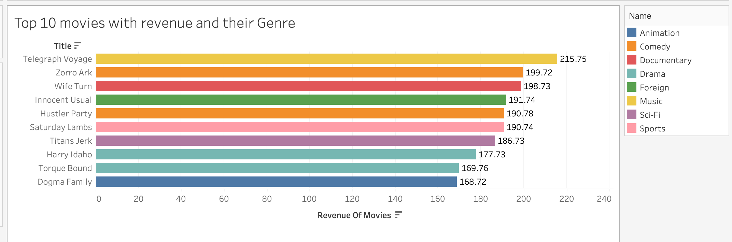
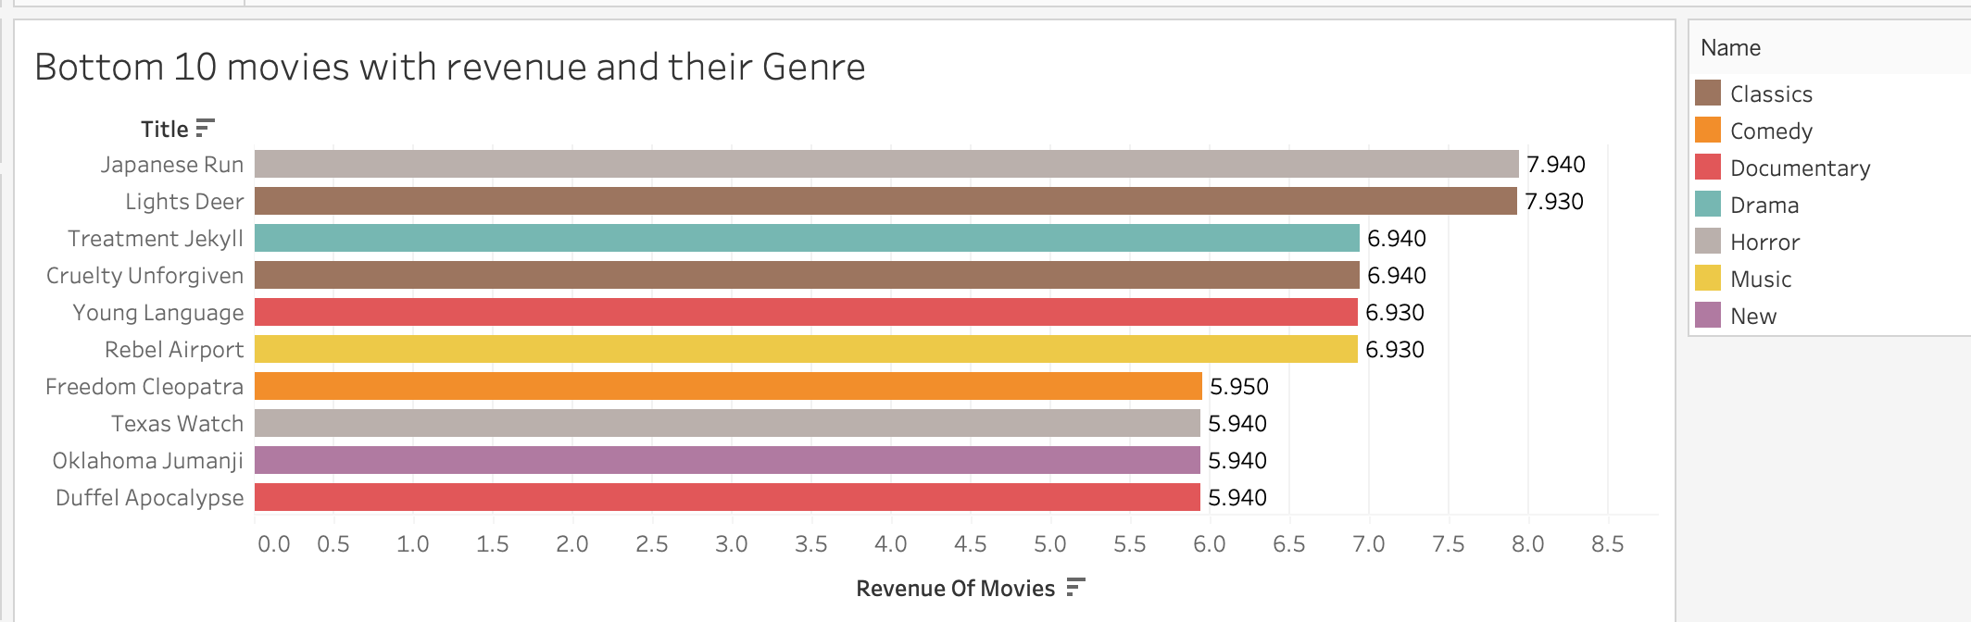

Which movies contributed the most/least to revenue gain?
As we can see from both the charts, the top 5 Most revenue generating movie genres are: “Music”, “Comedy”, “Documentary”, “Foreign”, and “Sports” And top 5 Least revenue generating movie genres are: “Horror”, “Documentary”, “New”, “Comedy”, and “Music”.
One conclusion we can be sure of, is that Genre is not the Revenue making factor as we see top revenue making genres present in the bottom revenue as well.

Slide 6
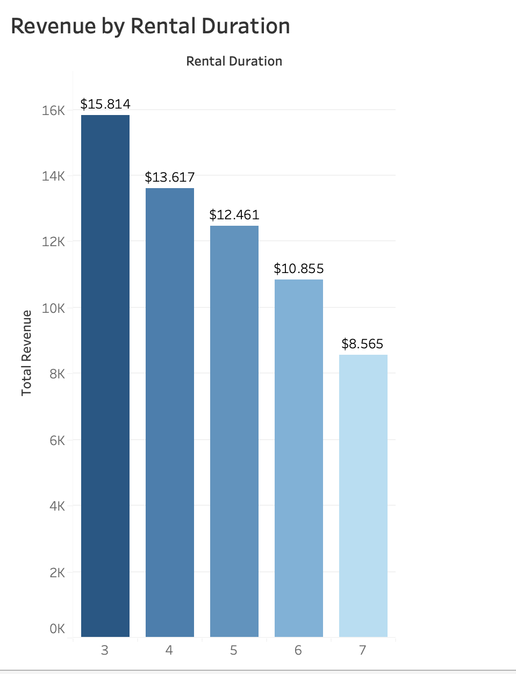
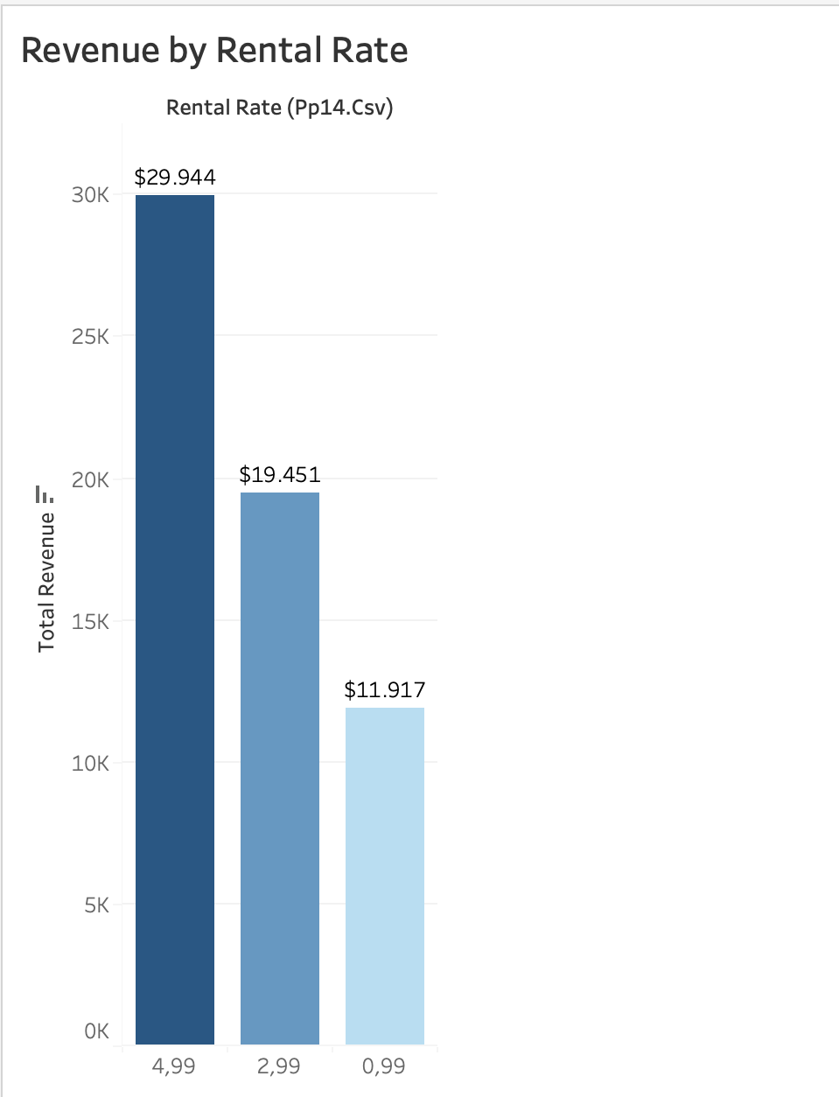
REVENUE BY RENTAL DURATION AND RENTAL RATE
Higher revenue seems to have been from films of shorter rental duration, not necessarily from the longer duration rentals.
Promote films with high rental rate by providing rewards and discounts to customers.

Slide 7
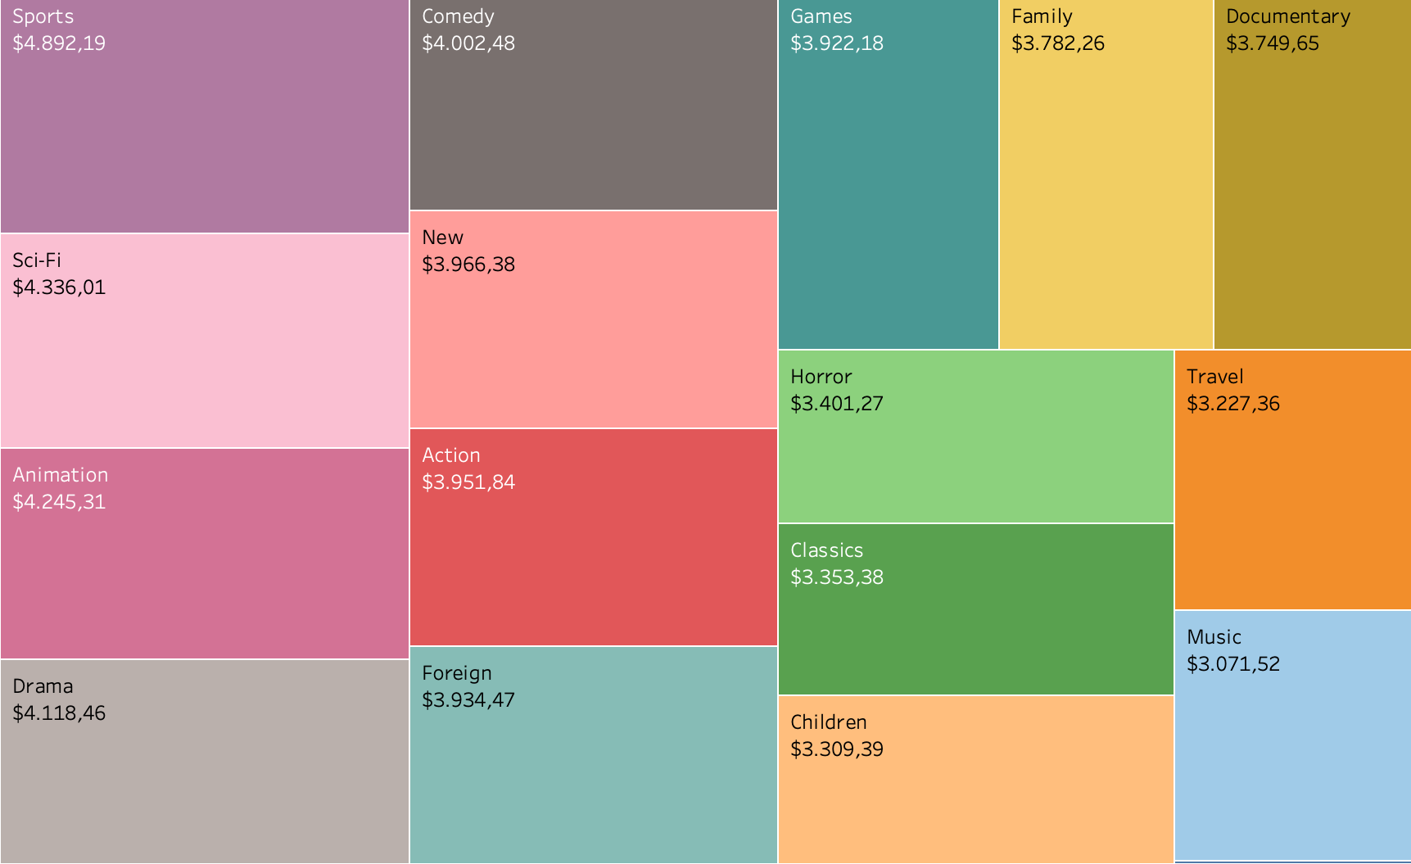

Rental Revenue by Category
The top 5 Categories are:
Sports
Sci-fi
Animation
Drama
Comedy

Slide 8
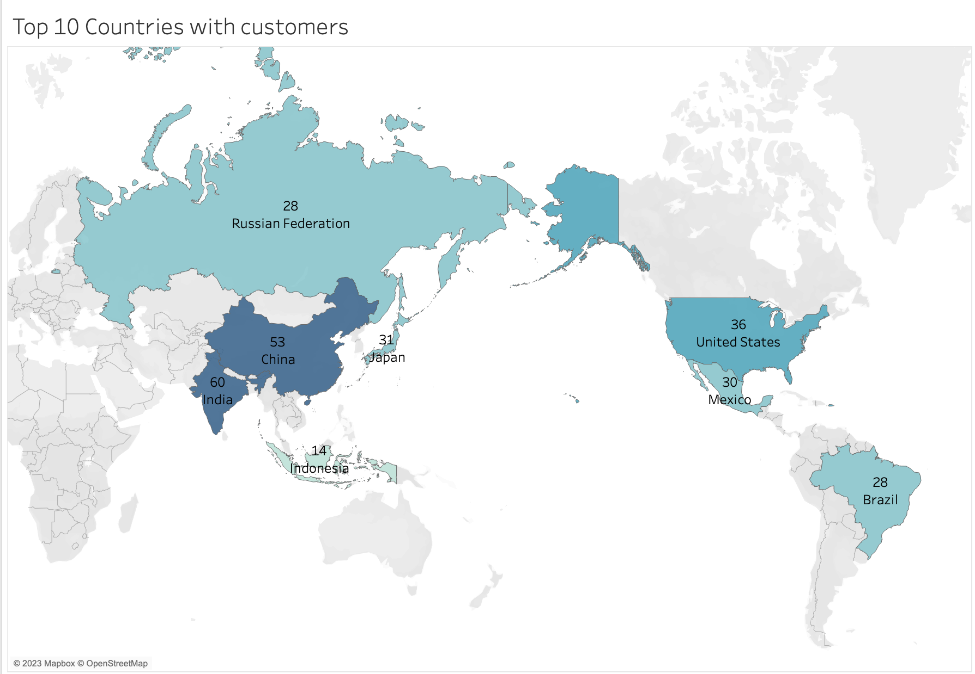

Top 10 countries of Rockbuster customers
Country | Number of customers
India | 60
China | 53
United States | 36
Japan | 31
Mexico | 30
Brazil | 28
Russian Federation | 28
Philippines | 20
Turkey | 15
Indonesia | 14
Rockbuster's services are used in 109 countries with the greatest number of customers in India, China, United States, Japan and Mexico.
Here we see that India has the highest Rockbuster customer count compared to all other countries, which has 60 as highest count.
Strong Customer base in India.

Slide 9
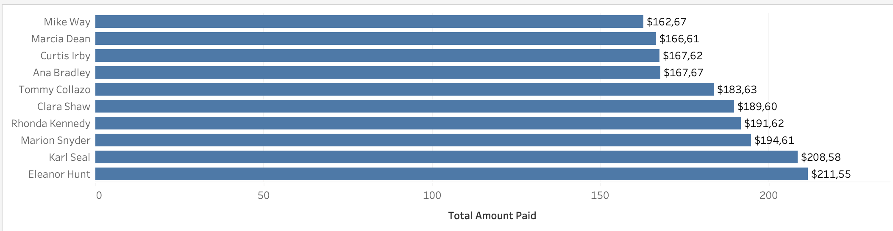
Top 10 Customers across the Region
Country | City | Number of Customer
United States | Aurora | 2
Mexico | Acua | 1
United States | Citrus Heights | 1
Japan | Iwaki | 1
India | Ambattur | 1
China | Shanwei | 1
Brazil | So Leopoldo | 1
Russian Federation | Teboksary | 1
China | Tianjin | 1
Indonesia | Cianjur | 1
There are top two Customers who has spent $211,55 and $208,58
Customers are widely dispersed in different cities with mostly one customer per city except for Aurora in the United States.
The customer team would like to reward 5 highest paying customers for their loyalty.

Slide 10
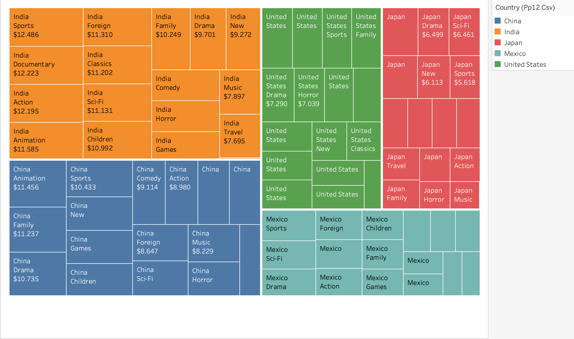
Leading categories in Top 5 Countries
Leading category in India, United States and Mexico: Sports
In China Animation followed by Sports
Leading category in Japan: New
Promote films from Sports category in the respective countries.

Slide 11
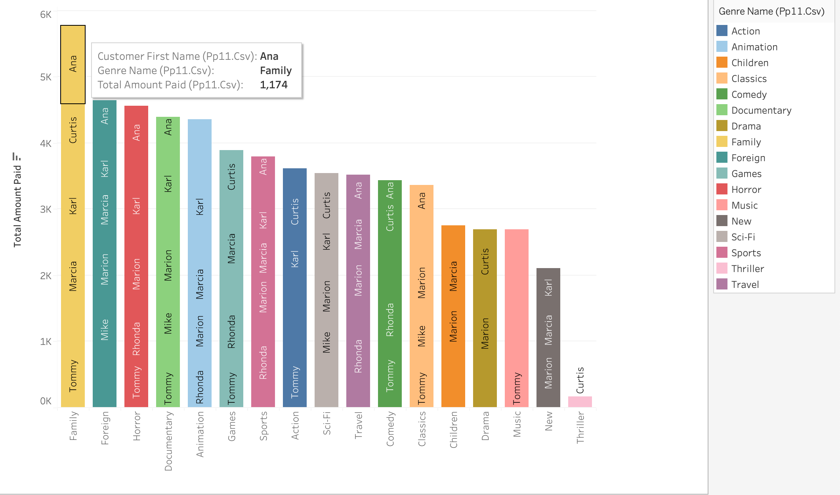
What do our Top Customers watch
Our top customers are watching more Family, Foreign, Horror and Documentry Movies.
Thriller movies has only one top customer: Curtis Irby.
There is no dramatic difference among all the genres.

Slide 12
What do our Top Customers willing to pay?
Country | Number of Customers | Revenue
India | 1422 | 6034.78
China | 1297 | 5251.03
United states | 869 | 3685.31
Japan | 749 | 3122.51
Mexico | 718 | 2984.82
Brazil | 681 | 2919.19
Russian Federation | 638 | 2765.62
Philippines | 530 | 2219.70
Turkey | 351 | 1498.49
Indonesia | 331 | 1352.69
Here, we can see more detail about customer demographics including the countries with the most customers and revenue as well as the top 5 Rockbuster customers.
Customer ID | First Name | Last Name | Country | City | Revenue
225 | Arlene | Harvey | India | Ambattur | 111.76
424 | Kyle | Spurlock | China | Shanwei | 109.71
240 | Marlene | Welch | Japan | Iwaki | 106.77
486 | Glen | Talbert | Mexico | Acua | 100.77
537 | Clinton | Buford | United States | Aurora | 98.76
The customer team is looking into rewarding these customers for their loyalty.

Slide 13
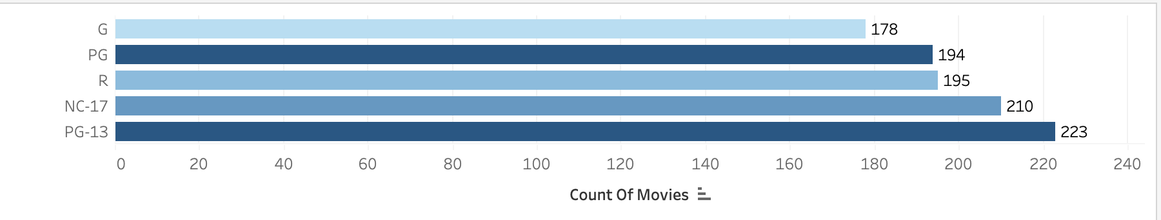
Rating Popularity
When we analyzed rental rates of each movie rating, we discovered that PG-13 movies are the most popular amongst our costumers, while G-rated movies are the least popular.
We can see here that there is no significant difference most popular and least popular ratings so we can not exclude the G rating out of the equation.

Slide 14
TOP PERFORMERS
RATING
PG-13 - $13,855.56
CUSTOMERS
As we are looking to acknowledge our customers, here are the top five:
Eleanor Hunt of Saint-Denis, Reunion -
$211.55
Karl Seal of Cape Coral, United States -
$208.58
Marion Snyder of Santa Brbara dOeste, Brazil - $194.61
Rhonda Kennedy of Apeldoorn, Netherlands
- $191.62
Clara Shaw of Molodetno, Belarus - $189.60
GENRE
Sports - $4,892.19
COUNTRY
India- $6,034.78
China - $5,251.03
United States - $3,685.31

Slide 15
Key Insights
Step 1: ONLINE VIDEO SERVICE LAUNCH
Using the current inventory launch online video rental service to India, China, and The United States as these three countries lead in number of customers, transaction count, and revenue generated.
Step 2: CUSTOMER APPRECIATION
Implement customer appreciation programs to recognize high lifetime value customers. Ideas include reward system where free subscription for 3 Months for current top 5 high lifetime value customers to promote the new online service.
Step 3: EXPANDING CURRENT INVENTORY
Add more movies to Rockbuster inventory starting with PG-13 and Sports movies as they generate the most revenue. Get more movies from different release years, as we only have movies from 2006.

Slide 16
Recommendations
Investment
Invest in incentivizing our top performing customers. (loyalty cards, discounts, special gifts etc.)
Inventory
Increase inventors for Sports, Sci-Fi, Animation, Drama and Comedy movies. Also increase inventory for the leading categories of top five countries.
Promotion
Invest in promoting Sports, Foreign and Documentary movies for India. Animation, Sports and Family for China. Sports, Drama and Documentary for US. New, Drama and Animation for Japan. Sports, Sci-Fi and Foreign for Mexico.
Language
Add foreign language movies to our catalogue, specifically those in Chinese dialects and Indian.
Higher Rental revenue from films of higher rental rate with $4.99 per film rental.
Revenue form Rental Rate
Notes:
When it comes to launching a new online streaming service, the visual design will play a crucial role. Therefore discuss the visuals with the design team to further boost customer interest.

Slide 17

Thank you for your Attention
Any Questions??
A more interactive analysis can be found at:
Rockbuster Analysis Tableau

